Slide 1
Software Architecture
Name:Umesh Taware
Class:ME Computer First year
Roll No.M1611003

Slide 2
INTERACTION ORIENTED SOFTWARE ARCHITECTURES
The primary objective of interaction-oriented architecture is to separate the interaction of user from data abstraction and business data processing
The interaction oriented software architecture decomposes the system into three major partitions:
Data module
Control module
View presentation module
The data module provides the data abstraction & all business logic.
The view presentation module is responsible for data output presentation and it may provide an input interface for user input.
The control module determines the flow of control involving view selections, communications between modules, job dispatching, and certain data initialization and system configuration actions.
Multiple view presentations in different formats are allowed

Slide 3
INTERACTION ORIENTED SOFTWARE ARCHITECTURES
Two major style
Model-View-Controller (MVC)
Presentation-Abstraction-Control (PAC)
Both of MVC and PAC are used for interactive applications multiple talks and user interactions.
They are different in their flow of control and organization.
The PAC is an agent based hierarchical architecture
The MVC does not have a clear hierarchical structure and all three modules are connected together.

Slide 4
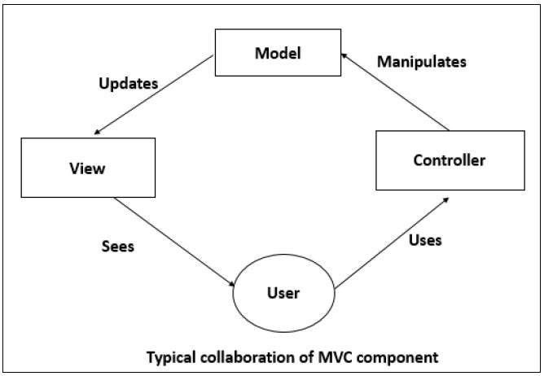
INTERACTION ORIENTED SOFTWARE ARCHITECTURES

Slide 5
Component based software Architecture
The primary objective of component-based architecture is to ensure component reusability
A component encapsulates functionality and behaviors of a software element into a reusable and self-deployable binary unit.
Component-oriented software design has many advantages over the traditional object-oriented approaches such as −
Reduced time in market and the development cost by reusing existing components.
Increased reliability with the reuse of the existing components.

Slide 6
Component based software Architecture
Component-based architecture focuses on the decomposition of the design into individual functional or logical components that represent well-defined communication interfaces containing methods, events, and properties.
It provides a higher level of abstraction and divides the problem into sub-problems, each associated with component partitions.
For those requirements that can be addressed with available components the following activities take place:
component qualification
component adaptation
component composition
component update
Detailed design activities commence for remainder of the system

Slide 7
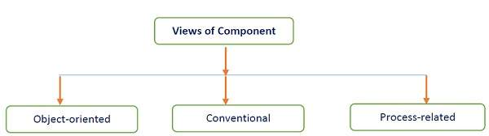
Component based software Architecture

Slide 8
Features of Compponent based Archetecture
The software system is decomposed into reusable, cohesive, and encapsulated component units.
Each component has its own interface that specifies required ports and provided ports; each component hides its detailed implementation.
A component should be extended without the need to make internal code or design modifications to the existing parts of the component.
Depend on abstractions component do not depend on other concrete components, which increase difficulty in expendability.
Connectors connected components, specifying and ruling the interaction among components. The interaction type is specified by the interfaces of the components.
Components interaction can take the form of method invocations, asynchronous invocations, broadcasting, message driven interactions, data stream communications, and other protocol specific interactions.

Slide 9
Heterogenous Software Architecture
Multiple CPU Single GPU systems
Asymmetric Multicore Processors (AMP)
Combination of general-purpose big and small cores
Trade-off between performance & power consumption
Usually “on chip” AMP’s
Single-ISA architectures
Similar to AMP but have same instruction sets among cores
“small” processors can support in-order execution
“big ones can support out-of-order execution
HSA defines a unified virtual address space for compute devices: where GPUs traditionally have their own memory, separate from the main (CPU) memory, HSA requires these devices to share page tables so that devices can exchange data by sharing pointers.

Slide 10
Heterogenous Software Architecture
This is to be supported by custom memory management units.[2]:6–7 To render interoperability possible and also to ease various aspects of programming, HSA is intended to be ISA-agnostic for both CPUs and accelerators, and to support high-level programming languages.
HSA Intermediate Layer (HSAIL), a virtual instruction set for parallel programs
similar[according to whom to LLVM Intermediate Representation and SPIR (used by OpenCL and Vulkan)
finalized to a specific instruction set by a JIT compiler
make late decisions on which core(s) should run a task
explicitly parallel
supports exceptions, virtual functions and other high-level features
syscall methods (I/O, printf etc.)
debugging support

Slide 11
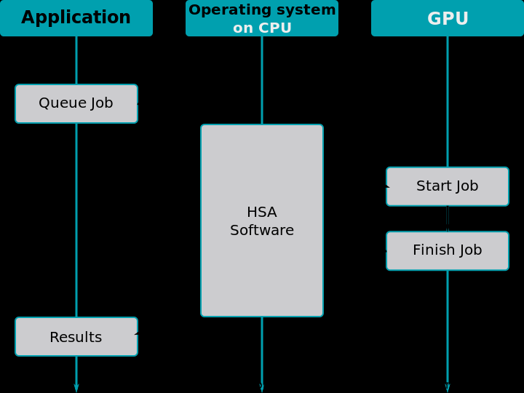
Steps performed when offloading calculations to the GPU on a HSA system, using the HSA functionality

Slide 12
Distributed Architecture
A distributed system can be demonstrated by the client-server architecture, which forms the base for multi-tier architectures.
The following table lists the different forms of transparency in a distributed system −
Transperency | Description
Access | Hides the way in which resources are accessed and the differences in data platform.
Location | Hides where resources are located.
Technology | Hides different technologies such as programming language and OS from user.
Migration / Relocation | Hide resources that may be moved to another location which are in use.
Replication | Hide resources that may be copied at several location.

Slide 13
Distributed Architecture
In this architecture, information processing is not confined to a single machine rather it is distributed over several independent computers.
Middleware is an infrastructure that appropriately supports the development and execution of distributed applications. It provides a buffer between the applications and the network.
It sits in the middle of system and manages or supports the different components of a distributed system.
Examples are transaction processing monitors, data convertors and communication controllers, etc.
The basis of a distributed architecture is its transparency, reliability, and availability.
Multi-tier architecture is a client–server architecture in which the functions such as presentation, application processing, and data management are physically separated. By separating an application into tiers, developers obtain the option of changing or adding a specific

Slide 14
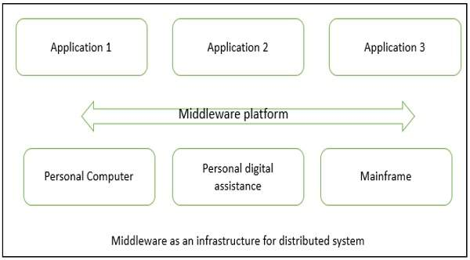
Middleware as an infrastructure for distributed system

Slide 15
Thank you

